Slide 1
4
INTEGRALS
Copyright © Cengage Learning. All rights reserved.

Slide 2
4.1
The Area Problem
Copyright © Cengage Learning. All rights reserved.

Slide 3
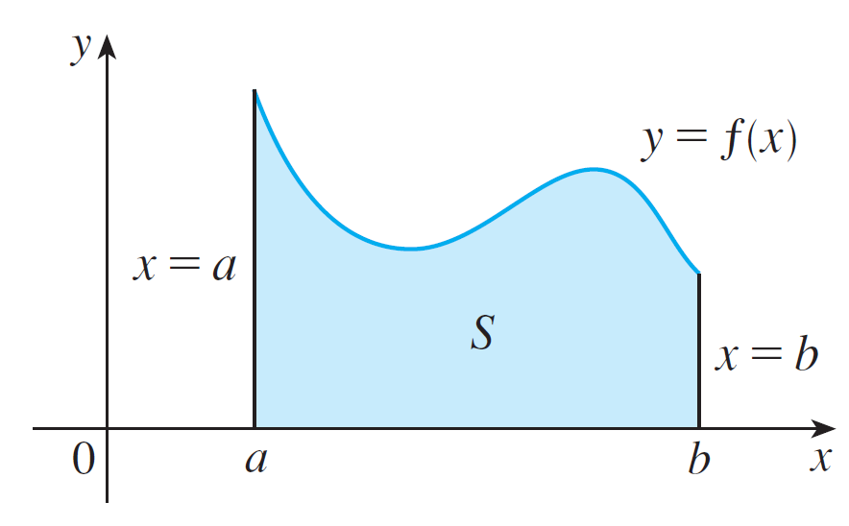
The Area Problem
We begin by attempting to solve the area problem: Find the area of the region S that lies under the curve y = f (x) from a to b.
This means that S, illustrated in Figure 1, is bounded by the graph of a continuous function f [where f (x) ≥ 0], the vertical lines x = a and x = b, and the x-axis.
Figure 1

Slide 4
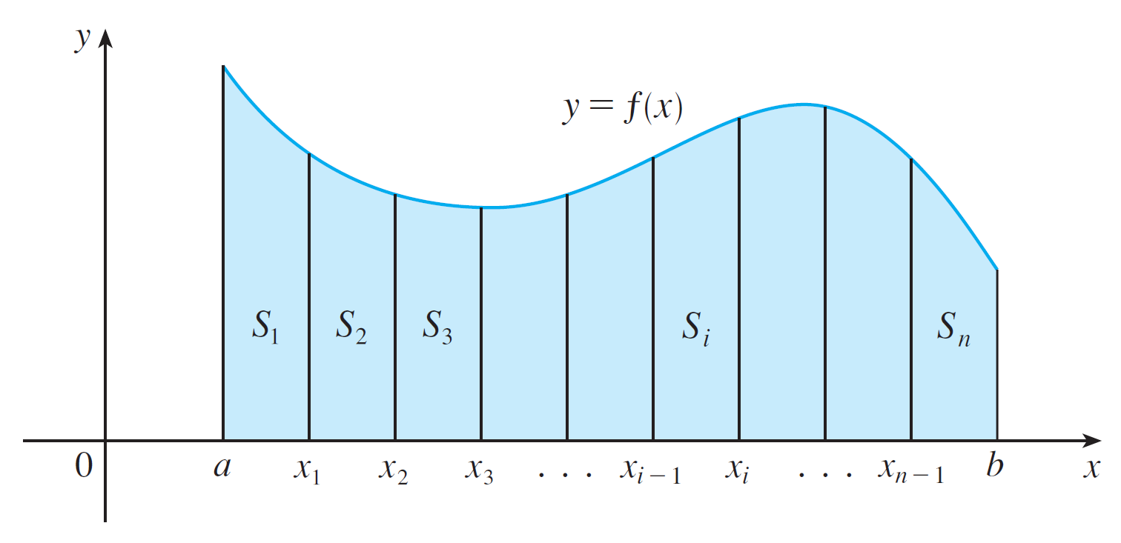
The Area Problem
We start by subdividing S into n strips S₁, S₂, …, S_{n} of equal width as in Figure 10.
Figure 10

Slide 5
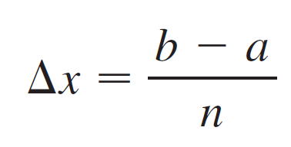
The Area Problem
The width of the interval [a, b] is b – a, so the width of each of the n strips is
These strips divide the interval [a, b] into n subintervals
where x₀ = a and x_{n} = b.

Slide 6
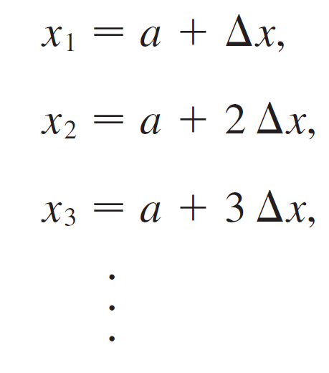
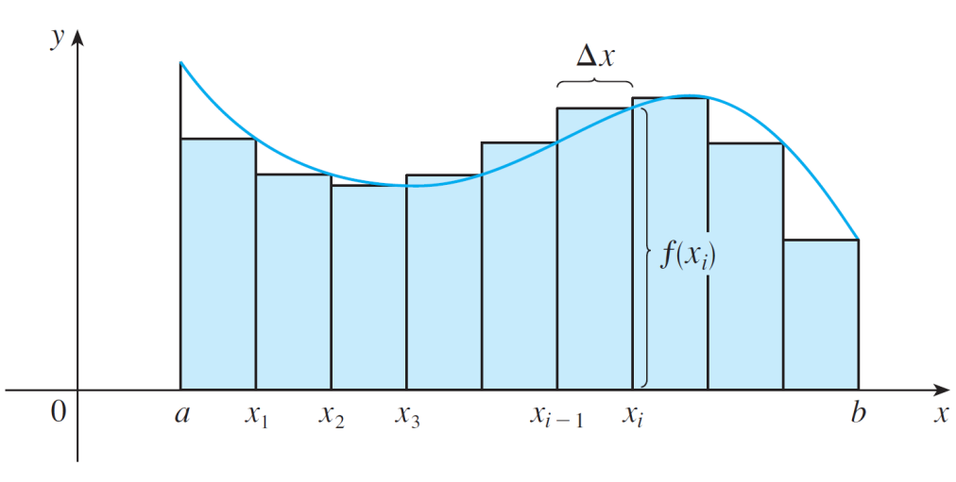
The Area Problem
The right endpoints of the subintervals are
Let’s approximate the i th strip
S_{i} by a rectangle with width Δx
and height f(x_{i}), which is the
value of f at the right endpoint
(see Figure 11).
Figure 11

Slide 7

The Area Problem
Then the area of the i th rectangle is f(x_{i}) x. What we think of intuitively as the area of S is approximated by the sum of the areas of these rectangles, which is

Slide 8
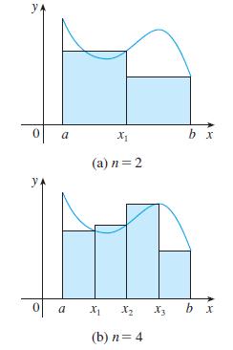
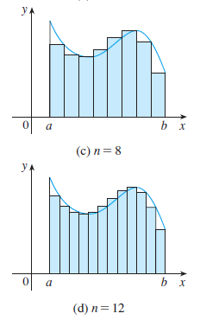
The Area Problem
Figure 12 shows this approximation for n = 2,4,6,8, and 12. Notice that this approximation appears to become better and better as the number of strips increases, that is as
Figure 12

Slide 9
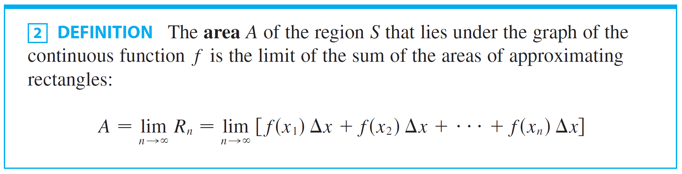
The Area Problem
Therefore we define the area A of the region S in the following way.
It can be proved that the limit in Definition 2 always exists, since we are assuming that f is continuous. It can also be shown that we get the same value if we use left endpoints:

Slide 10



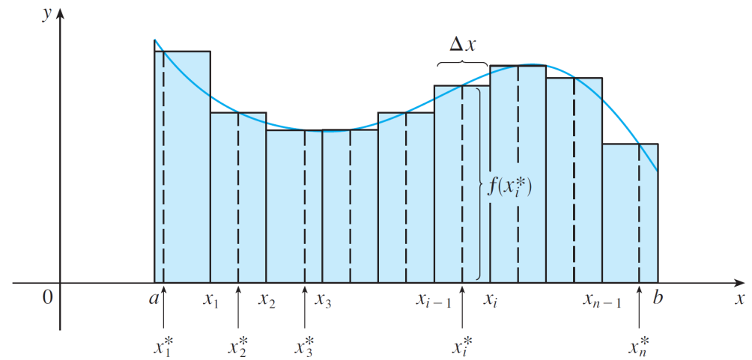
The Area Problem
In fact, instead of using left endpoints or right endpoints, we could take the height of the i th rectangle to be the value of f at any number in the i th subinterval .
We call the numbers the sample points.
Figure 13 shows approximating
rectangles when the sample
points are not chosen to be
endpoints.
Figure 13

Slide 11

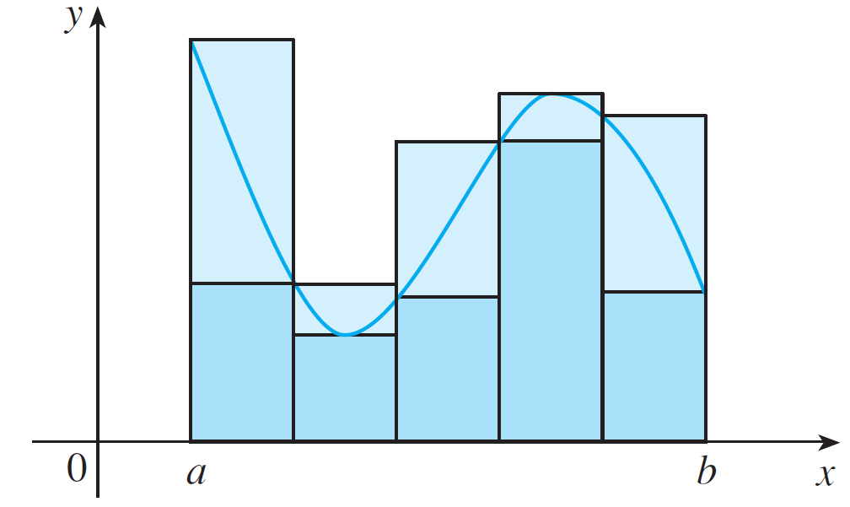
The Area Problem
So a more general expression for the area of S is
In general, we form lower (and upper) sums by choosing the sample points so that is the minimum (and maximum) value of f on the i th subinterval. (See Figure 14)
Lower sums (short rectangles) and upper sums (tall rectangles)
Figure 14

Slide 12
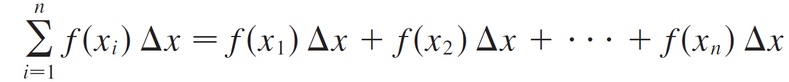
Sigma Notation
We often use sigma notation to write sums with many terms more compactly.
For instance,

Slide 13
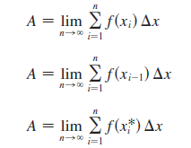

Sigma Notation
So the expressions for area in Equations 2, 3, and 4 can be written as follows:
We can also rewrite Formula 1 in the following way:

Slide 14
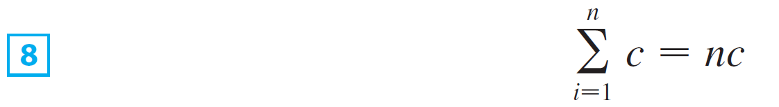
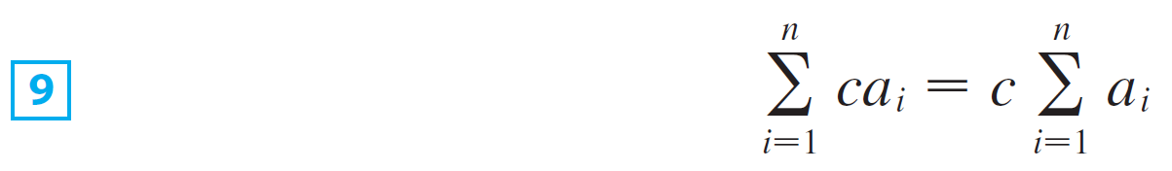
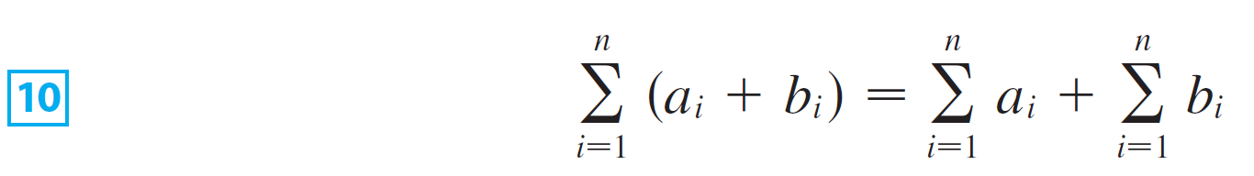
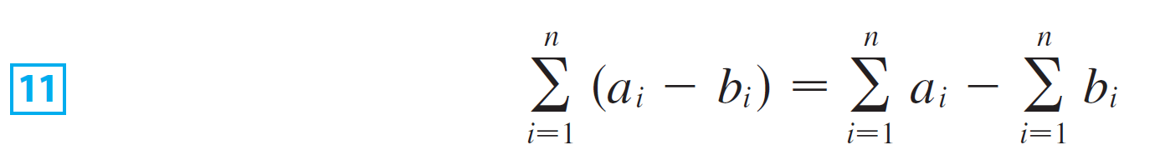
Sigma Notation
The remaining formulas are simple rules for working with sigma notation:

Slide 15
4.2
The Definite Integral
Copyright © Cengage Learning. All rights reserved.

Slide 16
The Definite Integral
We saw that a limit of the form
arises when we compute an area. It turns out that this same type of limit occurs in a wide variety of situations even when f is not necessarily a positive function.
Here we consider limits similar to [1] but in which f need not be positive or continuous and subintervals don’t necessarily have the same length.

Slide 17
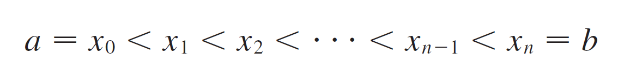
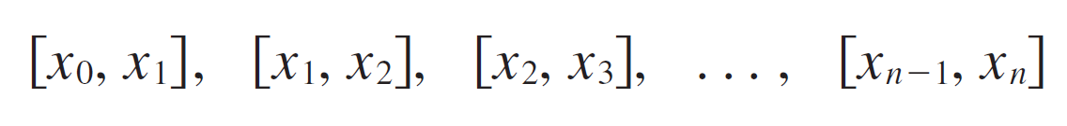
The Definite Integral
In general, we start with any function f defined on [a, b] and we divide [a, b] into n smaller subintervals by choosing partition points x₀, x₁, x₂ ,…, x_{n} so that
The resulting collection of subintervals
is called a partition P of [a, b].

Slide 18
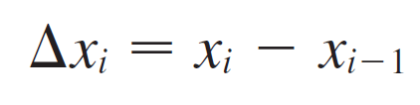


The Definite Integral
We use the notation Δx_{i} for the length of the i th subinterval [x_{i –1}, x_{i}].
Thus
Then we choose sample points in the subintervals with in the i th subinterval [x_{i –1}, x_{i}].
These sample points could be left endpoints or right endpoints or any numbers between the endpoints.

Slide 19
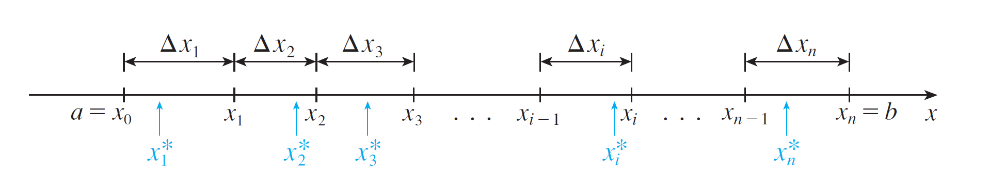

The Definite Integral
Figure 1 shows an example of a partition and sample points.
A partition of [a, b] with sample points
Figure 1

Slide 20
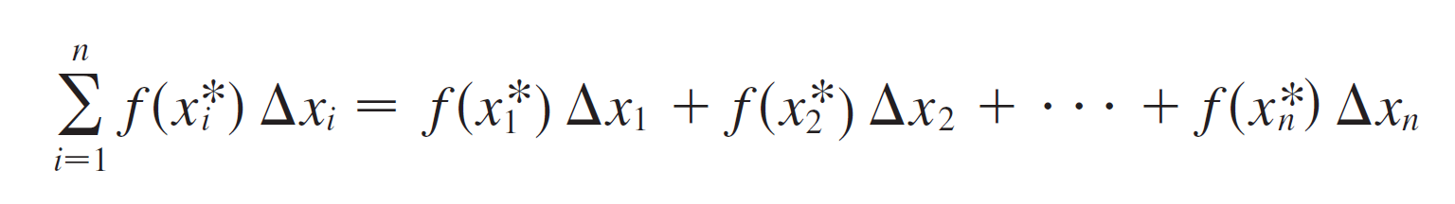
The Definite Integral
A Riemann sum associated with a partition P and a function f is constructed by evaluating f at the sample points, multiplying by the lengths of the corresponding subintervals, and adding:

Slide 21
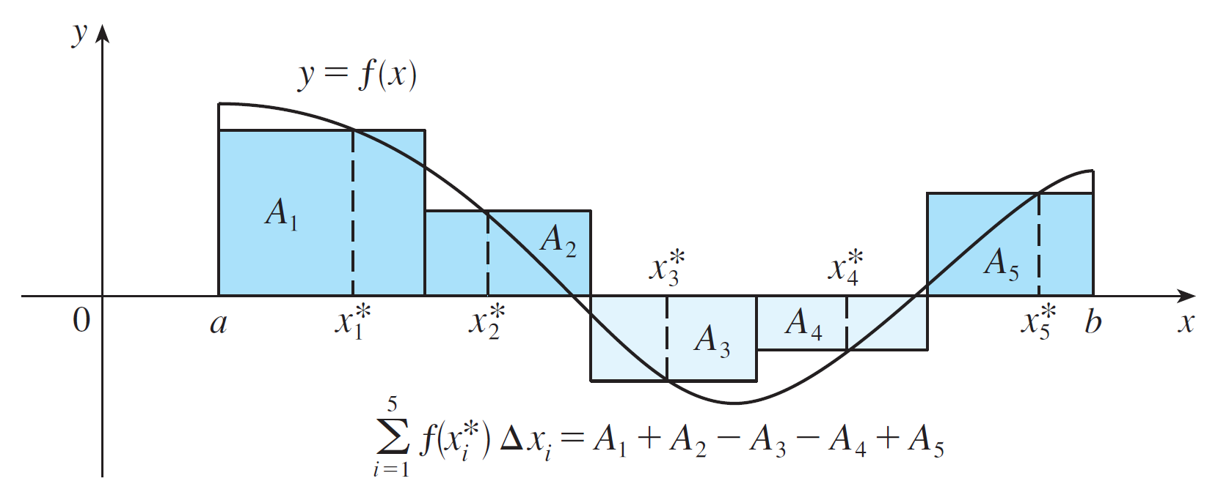
The Definite Integral
The geometric interpretation of a Riemann sum is shown in Figure 2.
A Riemann sum is the sum of the areas of the rectangles above the x-axis and the negatives of the areas of the rectangles below the x-axis.
Figure 2

Slide 22


The Definite Integral
Notice that if is negative, then is negative and so we have to subtract the area of the corresponding rectangle.
If we imagine all possible partitions of [a, b] and all possible choices of sample points, we can think of taking the limit of all possible Riemann sums as n becomes large by analogy with the definition of area.
But because we are now allowing subintervals with different lengths, we need to ensure that all of these lengths Δx_{i} approach 0.

Slide 23
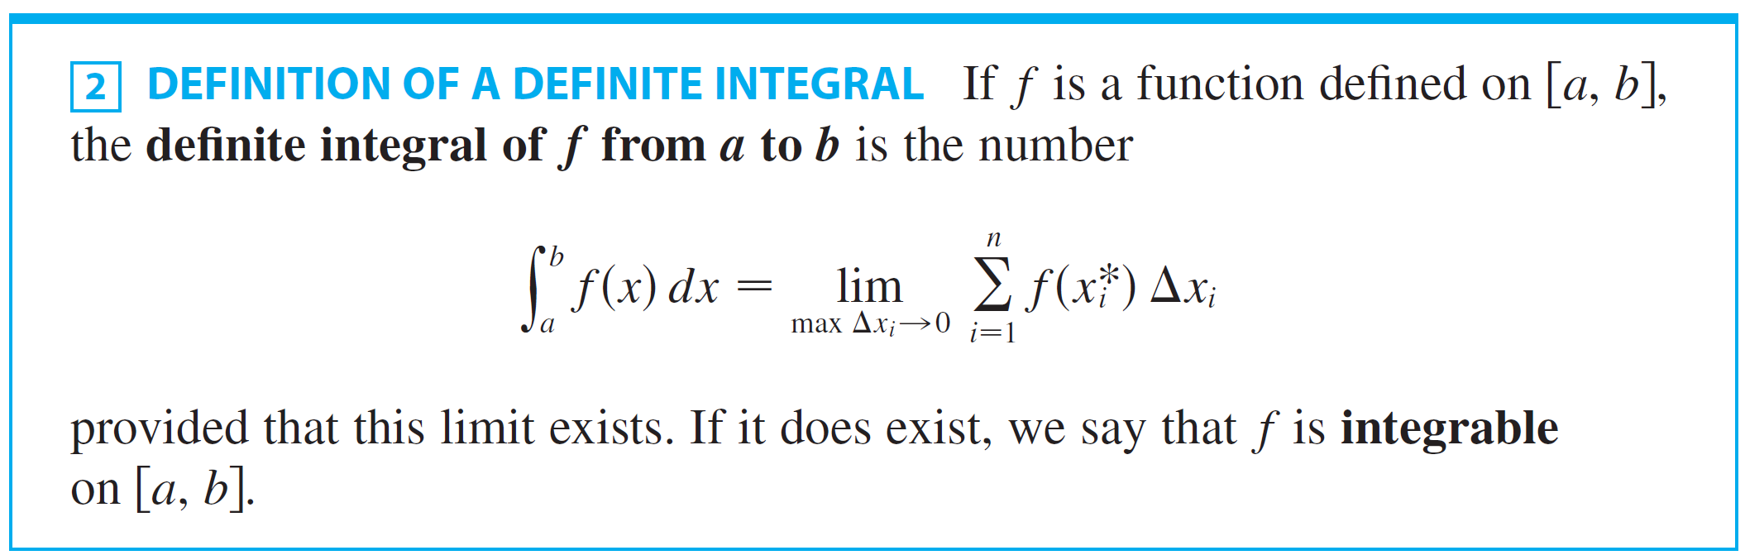
The Definite Integral
We can do that by insisting that the largest of these lengths, which we denote by max Δx_{i}, approaches 0.
The result is called the definite integral of f from a to b.

Slide 24

The Definite Integral
NOTE 1: The symbol ∫ was introduced by Leibniz and is called an integral sign.
It is an elongated S and was chosen because an integral is a limit of sums.
In the notation is called the integrand and a and b are called the limits of integration; a is the lower limit and b is the upper limit.

Slide 25



The Definite Integral
For now, the symbol dx has no official meaning by itself;
is all one symbol.
The dx simply indicates that the independent variable is x. The procedure of calculating an integral is called integration.
NOTE 2: The definite integral is a number; it does not depend on x. In fact, we can use any letter in place of x without changing the value of the integral:

Slide 26
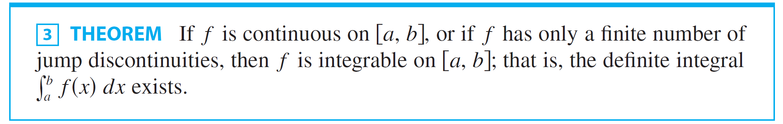
The Definite Integral
We have defined the definite integral for an integrable function, but not all functions are integrable. The following theorem shows that the most commonly occurring functions are in fact integrable.

Slide 27



The Definite Integral
If f is integrable on [a, b], then the Riemann sums in Definition 2 must approach as max no matter how the partitions and sample points are chosen.
So in calculating the value of an integral we are free to
choose partitions P and sample points to simplify the calculation.
It’s often convenient to take P to be a regular partition; that is, all the subintervals have the same length Δx.

Slide 28
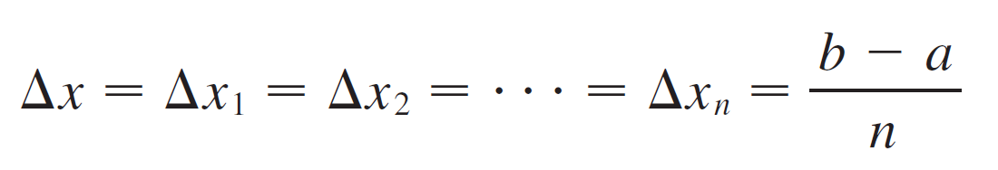
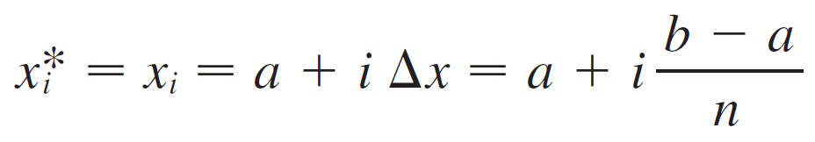
The Definite Integral
Then
and
If we choose to be the right endpoint of the i th subinterval, then

Slide 29


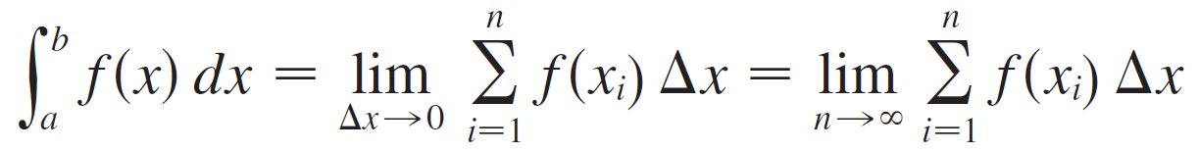
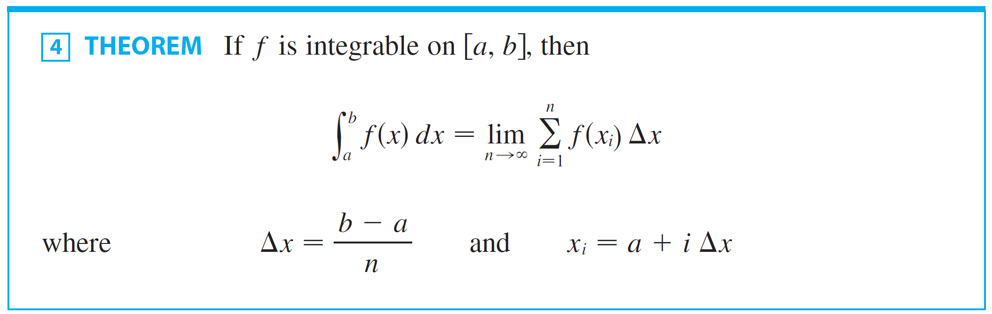
The Definite Integral
In this case, max as , so Definition 2 gives
In computing the value of an integral, Theorem 4 is much easier to use than Definition 2.

Slide 30
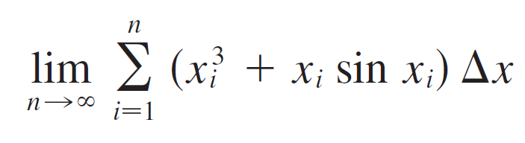

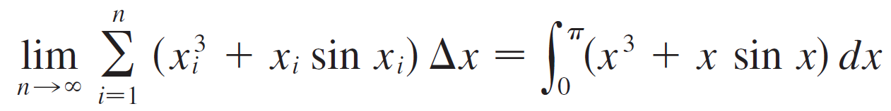
Example 1
Express
as an integral on the interval [0, π ].
Solution:
Comparing the given limit with the limit in Theorem 4, we see that they will be identical if we choose
.
We are given that a = 0 and b = π.
Therefore, by Theorem 4, we have

Slide 31
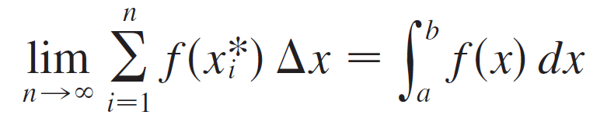
The Definite Integral
In general, when we write
we replace lim Σ by ∫, by x, and Δx by dx.

Slide 32
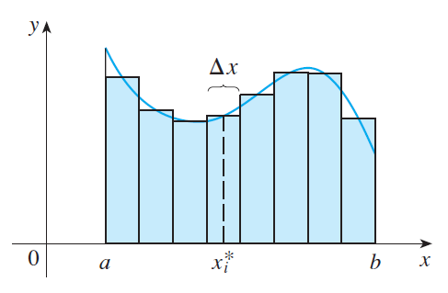

The Definite Integral
NOTE 3: If f happens to be positive, then the Riemann sum can be interpreted as a sum of areas of approximating rectangles (see Figure 3).
Figure 3

Slide 33

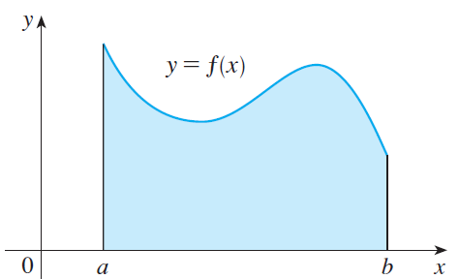

The Definite Integral
By comparing Theorem 4 with the definition of area in Section 4.1, we see that the definite integral
can be interpreted as the area under the curve y= f (x) from a to b. (See Figure 4.)
Figure 4

Slide 34
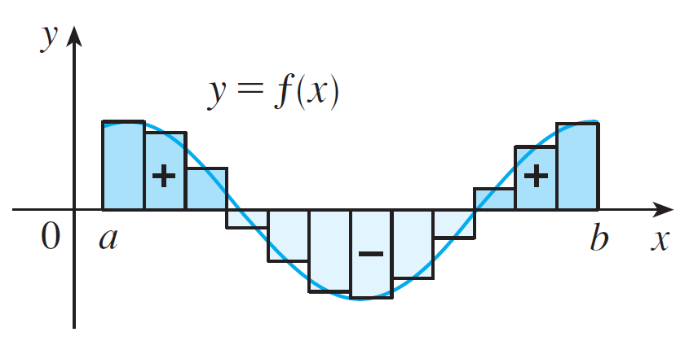

The Definite Integral
If f takes on both positive and negative values, as in Figure 5, then the Riemann sum is the sum of the areas of the rectangles that lie above the x-axis and the negatives of the areas of the rectangles that lie below the x-axis (the areas of the dark blue rectangles minus the areas of the light blue rectangles).
is an approximation to the net area.
Figure 5

Slide 35
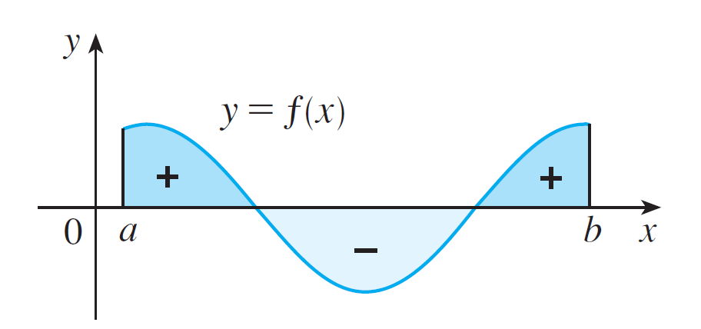
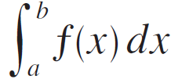
The Definite Integral
When we take the limit of such Riemann sums, we get the situation illustrated in Figure 6.
is the net area.
Figure 6

Slide 36
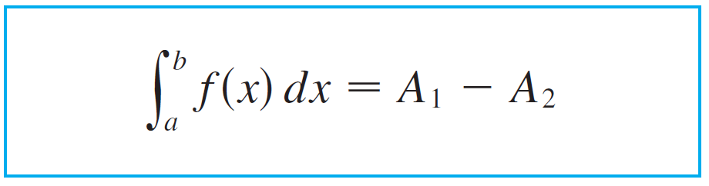
The Definite Integral
A definite integral can be interpreted as a net area, that is, a difference of areas:
where A₁ is the area of the region above the x-axis and below the graph of f, and A₂ is the area of the region below the x–axis and above the graph of f.

Slide 37
Evaluating Integrals
by using the definition

Slide 38
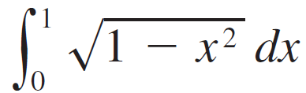
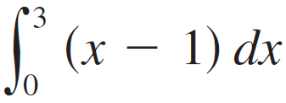
Example 3
Evaluate the following integrals by interpreting each in terms of areas.
(a) (b)

Slide 39




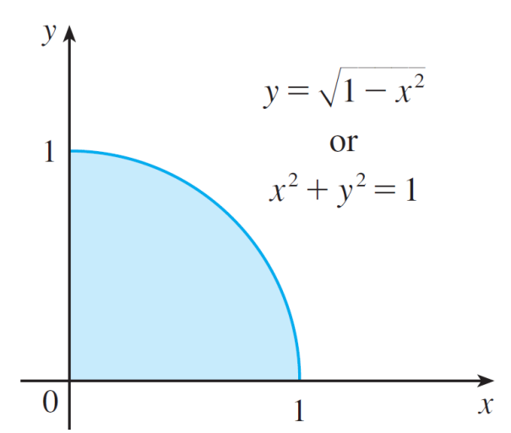
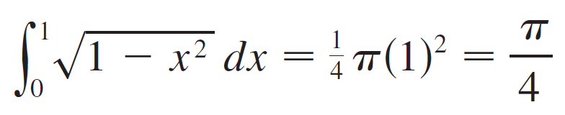
Example 3 - Solution
Solution:
Since , we can interpret this integral as the area under the curve from 0 to 1.
But, since , we get , which shows
that the graph of f is the quarter-circle with radius 1 in
Figure 10.
Therefore,
Figure 10

Slide 40
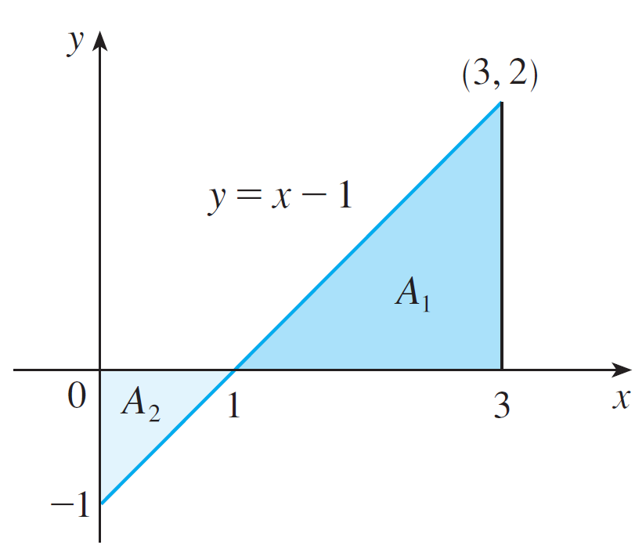
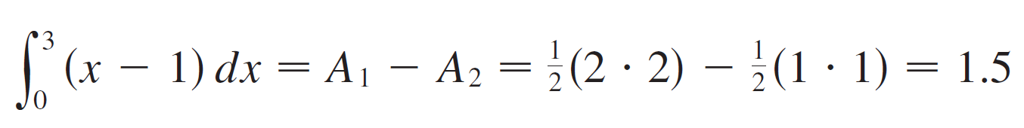
Example 3 – Solution
cont’d
(b) The graph of y = x – 1 is the line with slope 1 shown in
Figure 11.
We compute the integral as the difference of the areas
of the two triangles:
Figure 11

Slide 41
Properties of the Definite Integral

Slide 42

Properties of the Definite Integral
We now develop some basic properties of integrals that will help us to evaluate integrals in a simple manner. We assume that f and g are integrable functions.
When we defined the definite integral , we implicitly assumed that a < b.
But the definition as a limit of Riemann sums makes sense even if a > b.

Slide 43
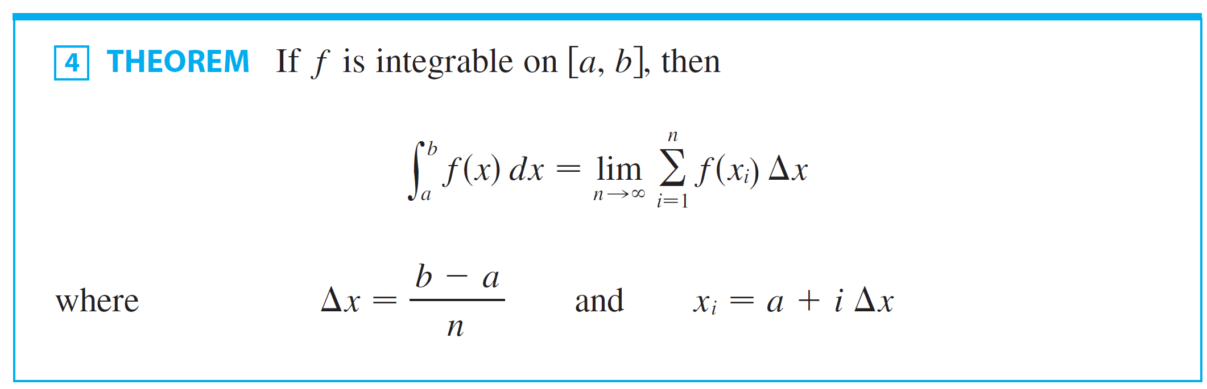
Properties of the Definite Integral
Notice that if we reverse a and b in Theorem 4, then Δx changes from (b – a)/n to (a – b)/n.

Slide 44
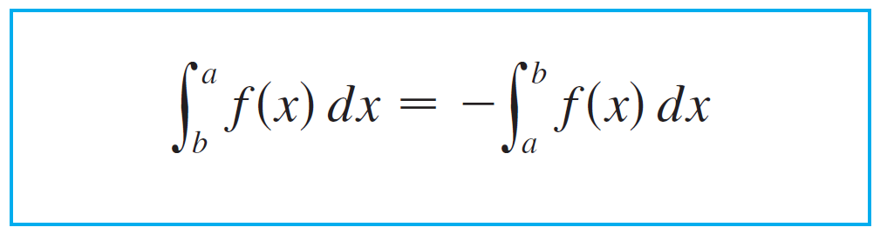

Properties of the Definite Integral
Therefore
If a = b, then Δx = 0 and so

Slide 45
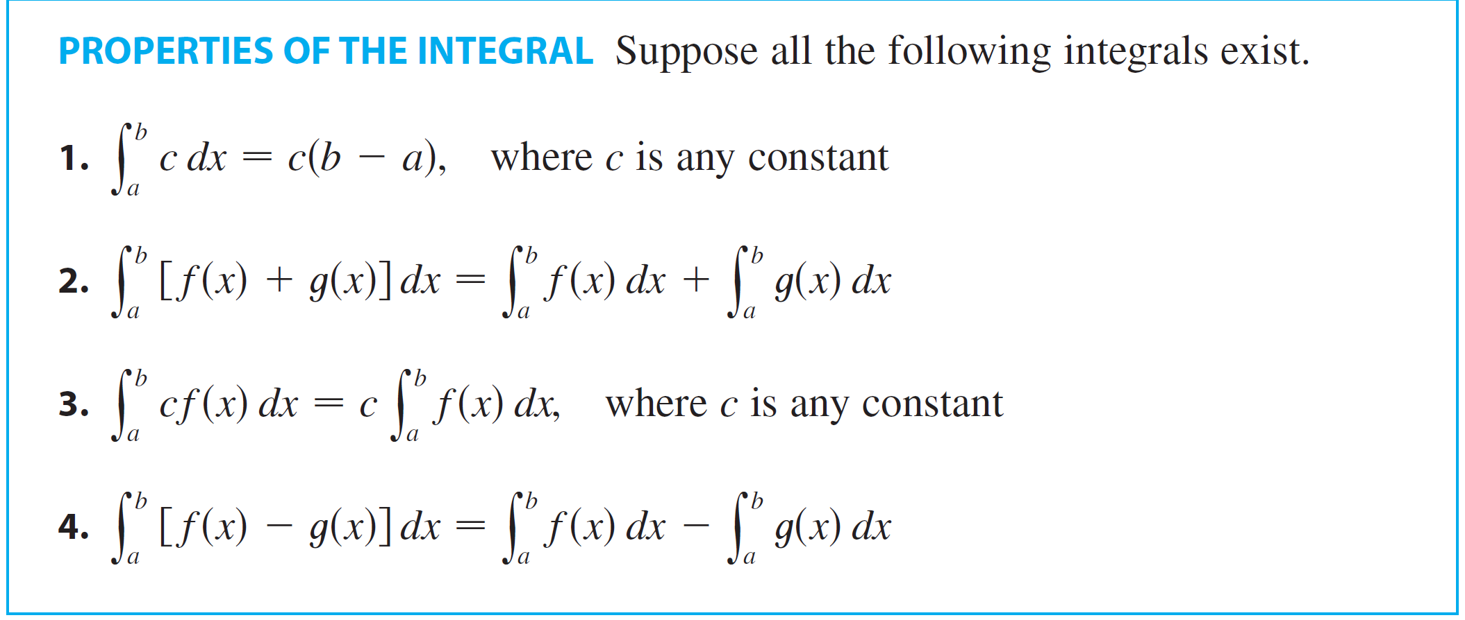
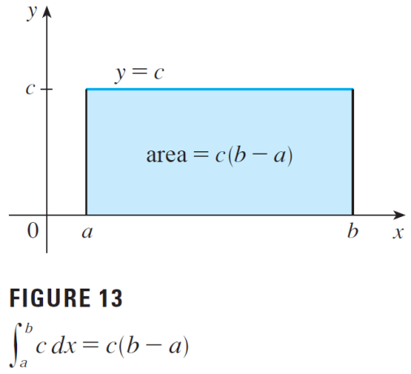
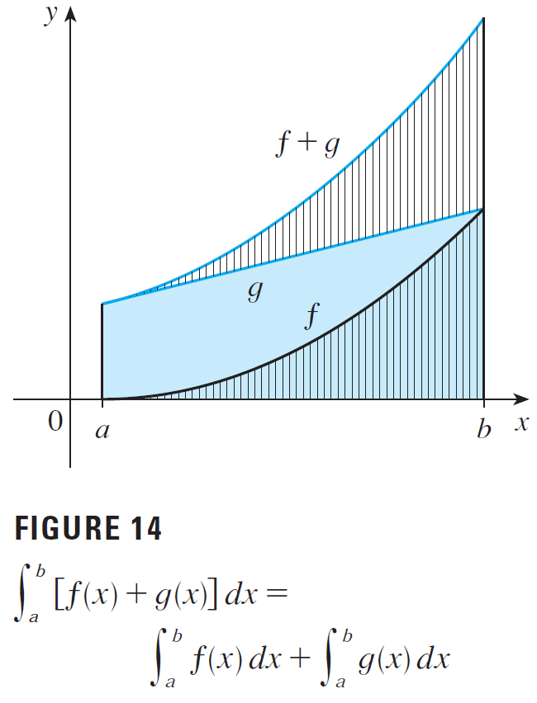
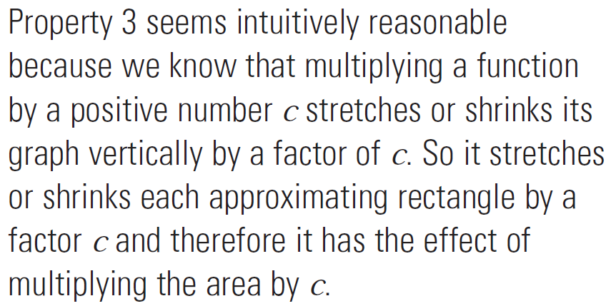
Properties of the Definite Integral

Slide 46
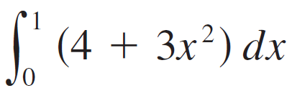






Example 5
Use the properties of integrals to evaluate .
Solution:
Using Properties 2 and 3 of integrals, we have
We know from Property 1 that
and we found in Section 4.1 that .
So

Slide 47


Properties of the Definite Integral
The next property tells us how to combine integrals of the same function over adjacent intervals:
For the case where f (x) ≥ 0 and a < c < b it can be seen from the geometric interpretation in Figure 16: The area under y = f (x) from a to c plus the area from c to b is equal to the total area from a to b.
Figure 16

Slide 48







Example 6
If it is known that and ,
find .
Solution:
By Property 5, we have
so

Slide 49


Properties of the Definite Integral
The following properties, in which we compare sizes of functions and sizes of integrals, are true only if a ≤ b.

Slide 50




Example 7
Use Property 8 to estimate
Solution:
Since is an increasing function, its absolute minimum on [1,4] is m = f (1) = 1 and its absolute maximum on [1, 4] is M = f (4) = = 2.
Thus Property 8 gives a decreasing function on [0, 1], its absolute maximum value is M = f (0) = 1 and its absolute minimum value is m = f (1) = e^{–1}.
Thus, by Property 8,
or

Slide 51


Properties of the Definite Integral
The result of Example 7 is illustrated in Figure 18.
The area under from 1 to 4 is greater than the area of the lower rectangle and less than the area of the large rectangle.
Figure 18

